Slide 1
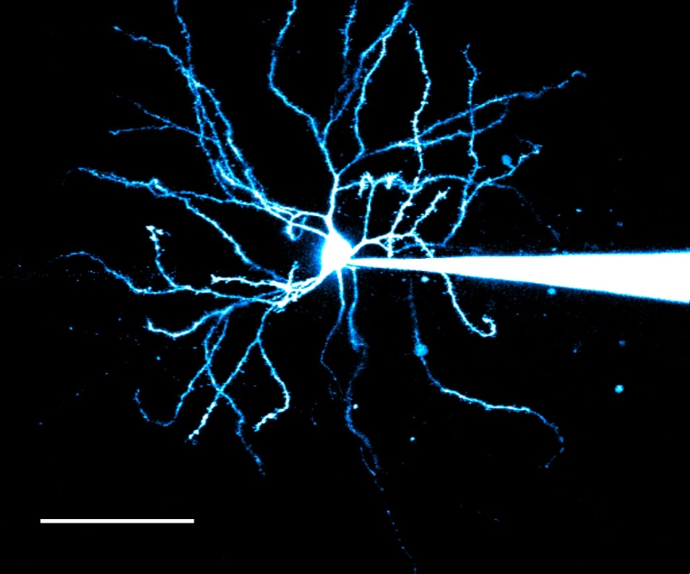
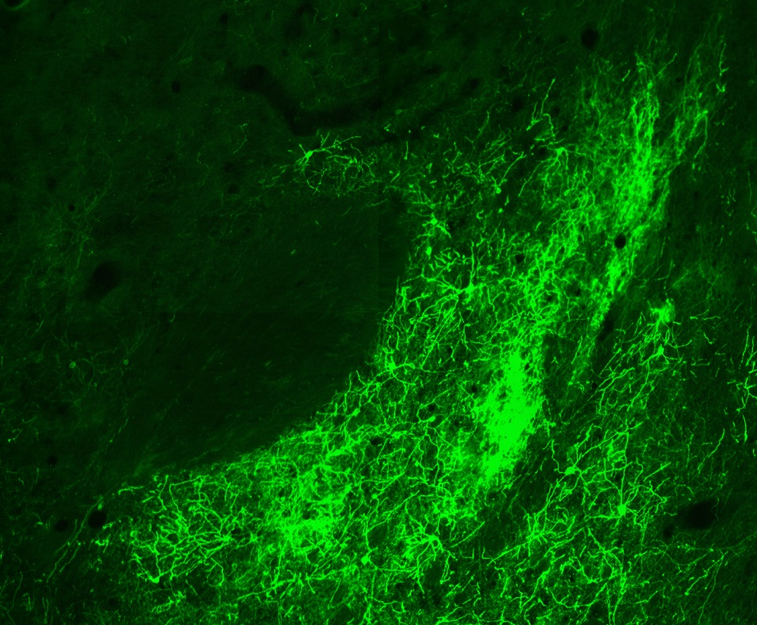



Optogenetic Modification of ADDICTION, DEPRESSION, AND SOCIAL DEFEAT
T.M. Hanna
Optogenetics in the Nucleus Accumbens
Spring 2016
tim.hanna@coyotes.usd.edu
Notes:
Photo on Left: MSN in NAc; Photo on right: NAc neurons fluorescing green after being injected with a virus

Slide 2
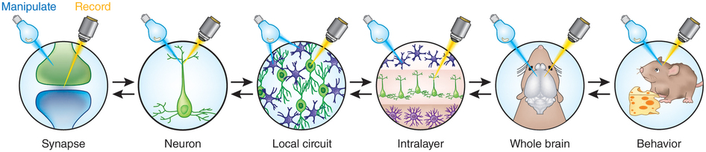

Getting Started: A short overview
Pp. 2-3
Main Article
Pp. 5-32
Background 1
Pp. 33-49
Background 2
Pp.50-66
=
Hours of Fun With Optogenetics

Slide 3


Getting Started
NAc → Gating the Zelda-Circuit
  Approach/avoidance
  Complex, ambiguous, and novel environments
  Motivation & discernment
Addiction, depression, & social defeat

Slide 4
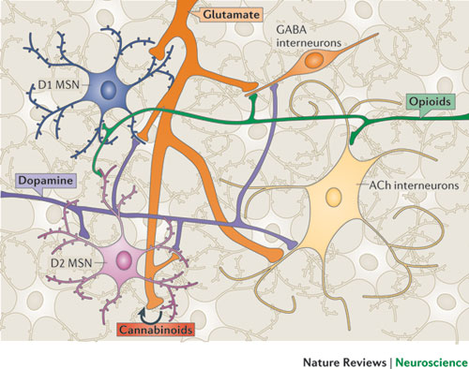
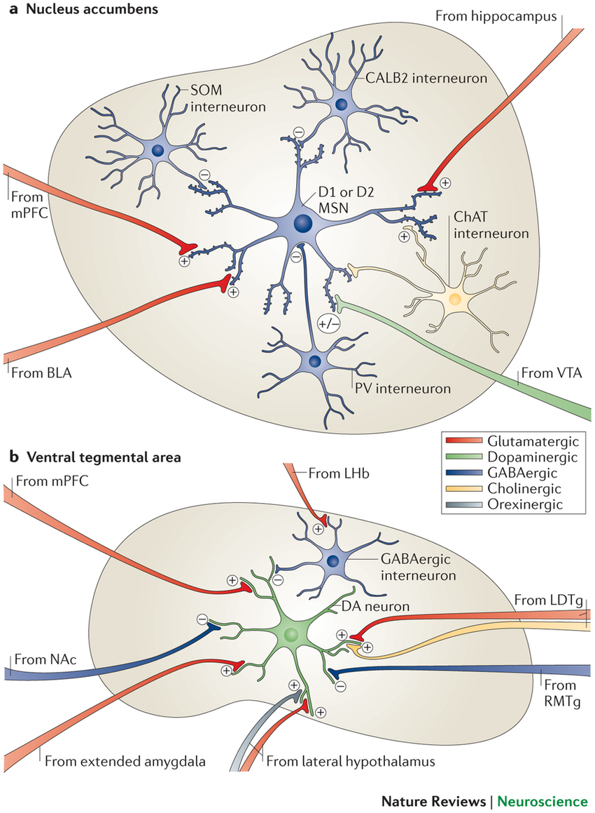
NAc Heterogeneity and DA Heteroreceptor Types Can Pose a Problem For Selective Stimulation
DA Heteroreceptors: mGlu, GABA_{B}, nAChR, KOR, ect., effect DA signaling
Notes:
SOM=Somatostatin Positive GABAergic interneurons
PV=Parvalbumin Positive GABAergic Interneurons
CALB2= Calretinin Positive Interneurons
LHb=Lateral Habenula-Conveys aversive and negative reward conditions through potent indirect inhibition of VTA DA neurons
LDTg= Lateral Dorsal Tegmental Nucleus-With the Pedunculopontine Tegmental Nucleus (PPTg) provide cholinergic afferents to several brain areas
RMTg=Rostromedial Tegmental Nucleus-
95% of NAc neurons are GABAergic medium spiny neurons (MSNs),Which can be further differentiated into:
Those that express the D1 dopamine receptor (D1-type MSNs) along with dynorphin and substance P
Those that express the D2 dopamine receptor (D2-type MSNs) along with encephalin.
Drug induction of ΔFOSB and the effects of ΔFOSB and G9a on cell morphology and behavior, differ between D1-type and D2-type MSNs,
About 1–2% of NAc neurons are spiny large cholinergic interneurons, which have been shown to play an important part in cocaine reward, and a similar number are GABAergic interneurons, the function of which are less well understood.

Slide 5
Difficult to examine DA signaling in isolation
  Electrical stimulation most common
    Lacks specificity
  Optogenetics
    Direct, selective activation
      DA terminal fields (VTA→NAc)
How does selective optic activation differ from traditional electric activation?
  DA volume transmission signaling?
Notes:
Volume Transmission= fluxes in extracellular DA tone

Slide 6
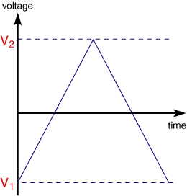
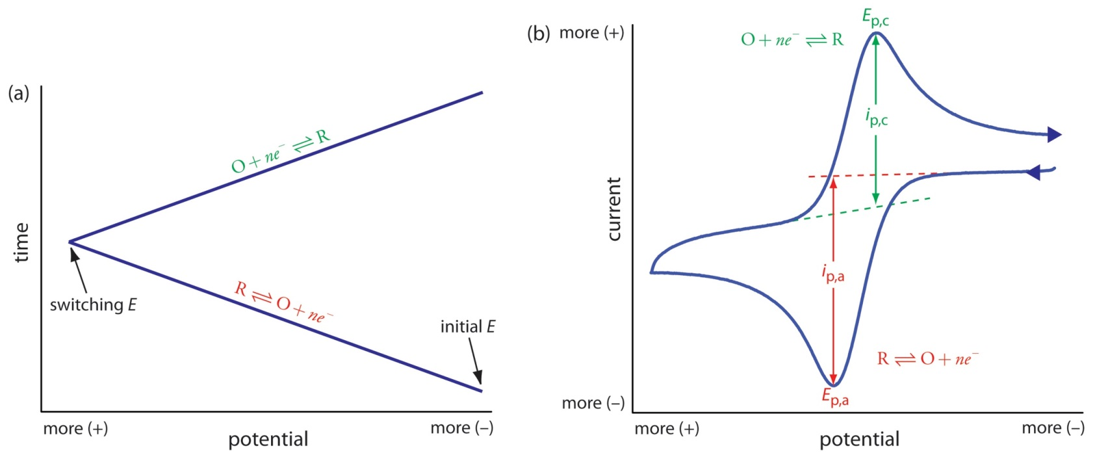


AnOx RedCat
Cyclic Voltammetry
FSCV=detection of extracellular DA levels with rapid temporal sensitivity
  Insights into DA signaling dynamics
Notes:
Oxidation at the Anode = Reduction at the Cathode
Here it is used to measure DA terminal properties and how they are altered following various manipulations – brain slice NAc

Slide 7


Electrical Stimulation
Stimulation field depolarization
  All axonal processes, dendrites, & cell bodies
Synchronous excitation unlikely
  Temporal NT release regionally distinct

Slide 8
Rapid Multi-Pulse Stimulations
Used for ES & OS
ES
  Stimulation trains → mimic/induce burst activity in VTA
    = DA release
  Control of non-DA neurons crucial
    Train stim. duration = activate metabotropic heteroreceptors on DA terminals
      Net inhibition of DA results

Slide 9
Goals
Characterize differences in release via MPSTs with each method
  Electrical vs. Optical
  In isolation
Evaluate contribution of non-DA transmitters (ES)
  GABAergic & cholinergic interneurons
    Insensitive to OS, but would be stimulated via ES
      Block GABA-R & nAChR

Slide 10
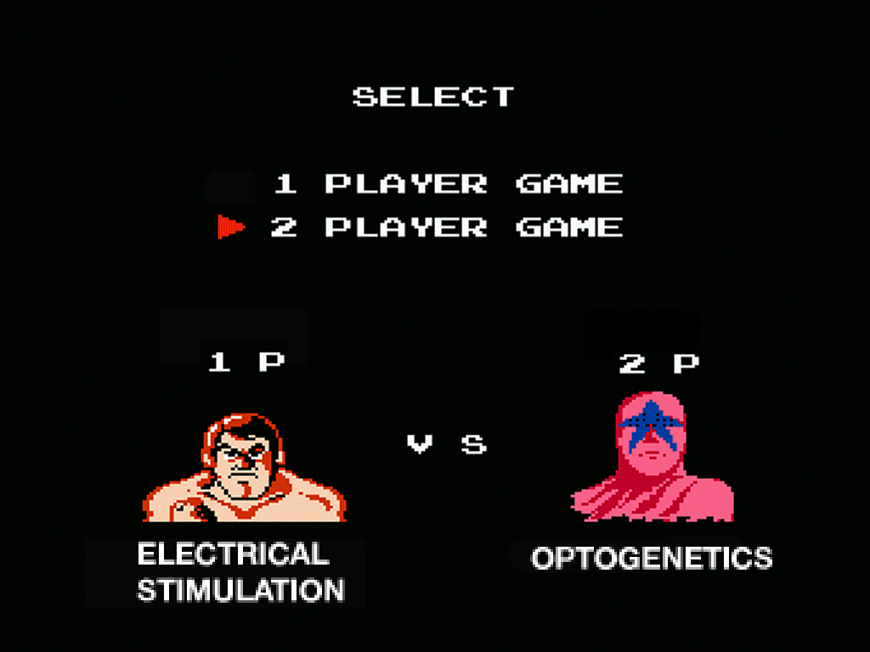
Notes:
Electrical Stimulation = Lacks Specificity
Optogenetics = Direct selective activation

Slide 11
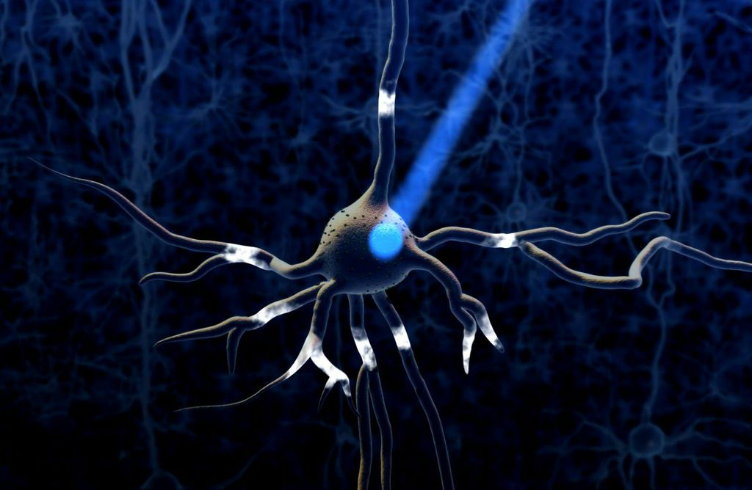
Optogenetics for 1° Paper

Slide 12
Adeno-Associated Virus (AAV2/5=AAV5)→ChR2
CAMKIIα Promoter Dependent (this study)
Serotype Most Divergent (55%)
Has Highest Efficiency in Transducing SN & Striatum (neurons & glia)

Slide 13

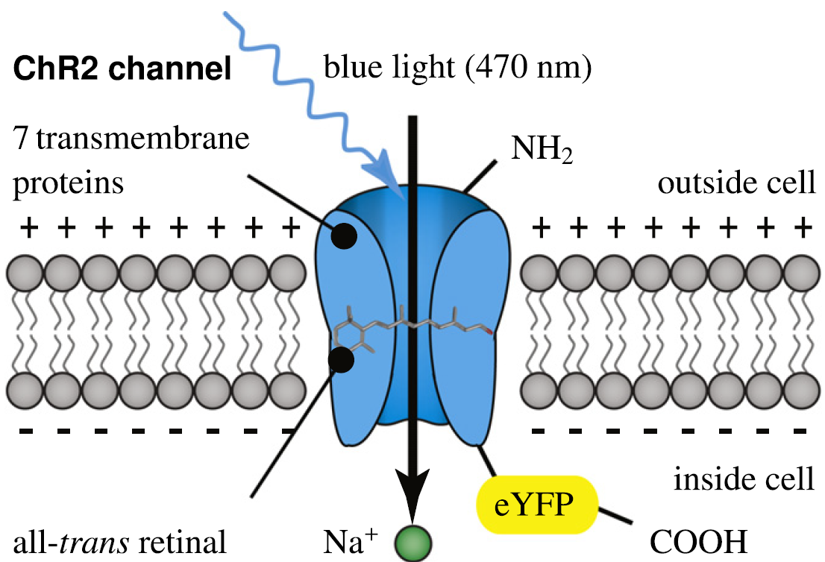
470 Mutha Effin Nano Meters Yo!

Slide 14
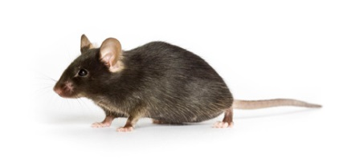

Animals
Materials & Methods
Adult C57BL/6J
  Ketamine (100 mg/kg) Xylazine (8mg/kg)
  Bi-hemispheric injection of AAV5
    Coding for hChR2(H134R)-eYFP
    Under control of CAMKIIα promoter
  20 min infusion
  10 min inactivity → diffusion
  Colony Return (28-117days; average 67days)→expression of ChR2

Slide 15

Animals
Materials & Methods
TH : CRE Mice
  Genotyped for males expressing CRE recombinase
  Surgery same as C57 mice
  Injected w/ CRE dependent virus
Ensure expression of ChR2 in TH+ neurons and axons
Ventral midbrain neurons → NAc Core are in Lateral VTA
Targeting ChR2 specifically to DA neurons projecting from the VTA

Slide 16
Viral Mediated ChR2 Expression: VTA & NAc
Results
Viral construct = robust GFP labeled ChR2 throughout VTA
  ChR2 expression co-localized with TH immunoreactivity in Ant. & Post. VTA
  ⇧ ChR2 in areas w/ dense DA soma
  ChR2 in striatum (esp. VTA/NAc)
    Little florescence in neighboring cortex

Slide 17
ChR2 & DA Labeled → VTA & NAc
Notes:
Expression of channelrhodopsin‐2 (ChR2)‐eYFP in the ventral tegmental area (VTA) and NAc. (a) Coronal midbrain section containing VTA from a virally transfected mouse following an incubation period of 76 days. ChR2‐eYFP expression immunolabeled with anti‐GFP (green), midbrain dopamine (DA) neurons immunolabelled for tyrosine hydroxylase (TH) (red), and merged overlay showing ChR2‐eYFP expression at the site of injection in the VTA. (b) Higher magnification of one hemisphere of VTA showing prominent co‐localization of ChR2‐eYFP and TH expression. (c) Coronal section of striatum showing expression of ChR2‐eYFP in the terminal fields of midbrain projection neurons, including NAc. (d) Higher magnification of the bracketed area in (c) reveals the density of ChR2‐eYFP positive terminals in the striatum relative to the neighboring cortex.

Slide 18
Light Stimulated DA Signals in NAc
Results
Single-pulse OS
  Identical to ES
    Shape, duration, RedOx peaks
20-pulse OS
  Similar to 20-Pulse ES
  However, resulted in  amplitude signals

Slide 19
Variance in Stimulation Sequence
Notes:
Electrical stimulation shows inhibition of dopamine (DA) release. Representative DA release curves resulting from 1, 5, 10, and 20 pulse stimulations, within the same location of NAc and with normalized 1 pulse baselines, are overlaid for light and electrical stimulation. The slope of the rising phase is perfectly straight and consistent for all light stimulations (a), while in (b), there is a rightward deflection in the curves, resulting in a reduction in the steepness of the slope. (c) Total 10 pulse stimulation data were analyzed for contribution per 100 ms to total DA signal. Electrical stimulation shows greater contribution during the first 100 ms of stimulation with less contribution to the total signal during the final 300 ms of stimulation duration, compared to light, which was more consistent throughout the duration of stimulation (n = 12/8). (d) There was no difference in the maximal rate of uptake between stimulation types (n = 16/11). ***p < 0.001 versus elec stim.

Slide 20
VMAT Blockade
Results
Ro 4-1248 (similar to reserpine)
  → Inhibits VMATs
    ☒ Transmitter entry into vesicle
  → Depletes vesicular release of DA
⬇OS signal incrementally → abolished after 1h
  Eliminates release from 20-pulse OS

Slide 21
NA+ Channel Blockade
Results
ChR2 = Ca++ permeable
  Is OS DA release AP-dependent?
  Does OS activation of ChR2 trigger NT release via Ca++ mediated AP?
  TTX→ Eliminated OS DA Release

Slide 22

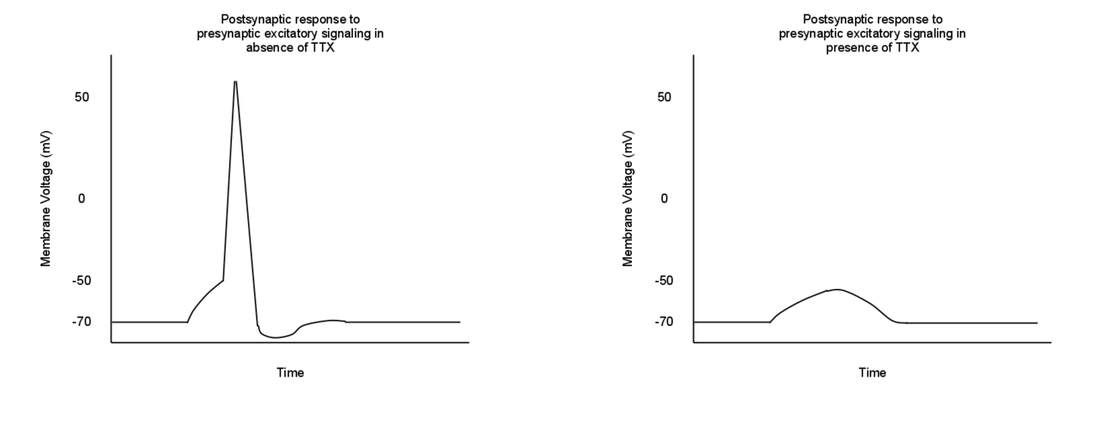
TETRODOTOXIN (TTX)
[X] Voltage Gated NA⁺ Channels

Slide 23
NA⁺ Channel Blockade & VMAT2 Inhibitor
Notes:
DA release is dependent on endogenous NA+ & vesicular transport
Light stimulation results in action potential dependent, vesicular release. A 20 pulse light stimulation produced ~ 10 μM dopamine (DA) release in baseline conditions. Following application of tetrodotoxin (TTX, 1 μM, red) the signal was completely eliminated. Inset: 20 pulse light stimulated signals were abolished in the presence of TTX (n = 3 slices from 2 animals, 3/2), as well as Ro 4‐1284 (n = 3/2); suggesting that release is dependent on both endogenous Na⁺ channels and vesicular transport. ***p < 0.001 versus predrug.
Ro 4-1284 inhibits VMAT2 (Vesicular Monoamine Transmitter 2)

Slide 24
ES vs. OS: Relative Responsiveness
Results
Single-pulse
  OS = less DA release than ES
Pulse train (5, 10, 20)
  OS = more DA release than ES for all pulse trains
  DA per pulse decreased, but less in OS than ES
Notes:
Multi‐pulse light stimulation results in greater dopamine (DA) release than electrical stimulation. DA release with 1, 5, 10, and 20 pulse stimulations with either electrical (red) or light (blue) stimulation of the same location (n = 12/8). (a) Average multi‐pulse (5, 10 and 20 pulses) DA release, presented as a percentage of the single pulse (1 pulse) baseline release, is greater using light stimulation versus electrical stimulation). (b) Average DA release per stimulus pulse (DA/p; total DA/# pulses), normalized to 1 pulse baseline release, decreases across multi‐pulse trains (5, 10, and 20 pulses) for both electrical and light stimulation; however, light stimulation results in less inhibition of DA/p than electrical stimulation (n = 12/8). *p < 0.05 versus elec stim; ***p < 0.001 versus elec stim.

Slide 25
Increased Sensitivity of Fields to OS
Results
ES
  41% of total ES DA release in first 100ms of train
  35% during final 300ms combined
OS
  28% DA release 1st 100ms
  49% DA release final 300ms
ES DA release = greater at stimulation onset; more rapid decline
OS more consistent DA release throughout stimulation

Slide 26
Notes:
Electrical stimulation shows inhibition of dopamine (DA) release. Representative DA release curves resulting from 1, 5, 10, and 20 pulse stimulations, within the same location of NAc and with normalized 1 pulse baselines, are overlaid for light and electrical stimulation. The slope of the rising phase is perfectly straight and consistent for all light stimulations (a), while in (b), there is a rightward deflection in the curves, resulting in a reduction in the steepness of the slope. (c) Total 10 pulse stimulation data were analyzed for contribution per 100 ms to total DA signal. Electrical stimulation shows greater contribution during the first 100 ms of stimulation with less contribution to the total signal during the final 300 ms of stimulation duration, compared to light, which was more consistent throughout the duration of stimulation (n = 12/8). (d) There was no difference in the maximal rate of uptake between stimulation types (n = 16/11). ***p < 0.001 versus elec stim.

Slide 27


????????????????????????????????????????????????????
ES recruits non-DA processes in the local environment & net effect is inhibition of DA release via heteroreceptors on the DA terminals
How do GABAergic and cholinergic interneurons influence DA release: ES vs. OS?

Slide 28
GABA Influence on DA Release
GABA Results
GABA_{A} X direct modulation of DA release at terminals
GABA_{B}R found on DA terminals
GABA_{B}R activation = ⬇ DA release
CGP 55845 used during 1 pulse & 20 pulse train
+ increase for ES; + increase OS 1 pulse (CAMKIIα); 0 effect for 20 Pulse CAMKIIα and TH: CRE
Notes:
GABAa does not directly modulate DA release at the terminal

Slide 29
Notes:
GABAergic modulation of dopamine (DA) release. (a) The GABA_{B} receptor antagonist CGP 55845 significantly increased electrically stimulated DA release with 20 pulse stimulation trains (n = 12/7), while having no effect on 20 pulse light stimulations in either optogenetic model tested. (b) CGP 55845 increased 1 pulse electric stimulated DA release and 1 pulse light stimulated DA release in models of non‐specific channelrhodopsin‐2 (ChR2) expression in ventral tegmental area (VTA) projection neurons (CaMKIIα; n = 12/7); but had no effect on 1 pulse light stimulated DA release in models targeting ChR2 specifically to DA neurons projecting from the VTA (TH : Cre; n = 8/4). **p < 0.01 versus predrug; ***p < 0.001 versus predrug.

Slide 30
Acetylcholine Influence on Stimulated DA Release
ACh Results
ACh prominent regulator of DA via nAChR (β2 subunit) on DA terminal
DHβE (competitive antagonist [α4β2]) nAChR (100nM)
Does ACh modulate sensitivity ES or OS?

Slide 31
Cholinergic Modulation of DA Release
Dihydro-β-erythroidine hydrobromide (DHβE)
DHβE X single-pulse elec. stim. DA release
No effect for OS
DHβE no effect of VTA→NAc DA projections (TH:Cre)
DHβE had no effect on ES or OS DA release @ 20 pulse
Notes:
Cholinergic modulation of dopamine (DA) release. (a) The nAChR antagonist DHβE significantly reduced single pulse electrically stimulated DA release (n = 11/6), with no effect on light stimulated DA release, within the same location, using non‐specific channelrhodopsin‐2 (ChR2) expression in ventral tegmental area (VTA) projection neurons (CaMKIIα; n = 11/6). DhβE also had no effect on single pulse light stimulated DA release in models targeting ChR2 specifically to DA neurons projecting from the VTA (TH : Cre; n = 8/4). DHβE had no effect on 20 pulse stimulated DA release with either electric or light stimulation (elec/CaMKIIα, n = 11/6; TH : Cre, n = 8/4). (b) DHβE increased the 20 to 1 pulse ratio of DA release resulting from electrical stimulation, with no effects on the ratio of DA release resulting from light stimulation. ***p < 0.001 versus predrug. (c) The percentage of the total DA signal contributed during each 100 ms across the 500 ms stimulation duration. In the presence DHβE (100 nM), electrical and light stimulation show comparatively similar release responsiveness across the 10 pulse stimulation. (n = 11/6)

Slide 32

Results
OS Better Than ES (Large Pulse Trains)
OS = less neg. modulated DA signal (local ACh + GABA)
DA Release Dependent on VMAT + voltage gated Na+ Channels
Ca++ entry via ChR2 not sufficient for independent release

Slide 33
NAc DA-type MSN projections
  D1-MSN→vPallidum, globus pallidum internal, VTA, & SN
    Positive reward
  D2-MSN→vPallidum
    Aversion
  Inhibition = opposing outcomes
  Pathway imbalance→ psych & neuro disease
This time AAV5 into NAc Bilaterally
D1:Cre
D2:Cre
Examination of excitatory synaptic input and intrinsic excitability in MSNs after CSDS
Notes:
D1-MSN vs. D2-MSN have opposing roles in reward, action-value, reinforcement, motor function, and sensitized responses to drugs of abuse

Slide 34
Animals
Materials & Methods
Male D1-GFP & D2-GFP (C57 background) Used for electrophysiological recording
Male D1-Cre & D2-Cre (C57 background) Used for OS & pharmacogenetic experiments
Cohorts 1 & 2 (8 wks)
CD1 breeders (≥ 3mo)
This time AAV5 into NAc Bilaterally

Slide 35
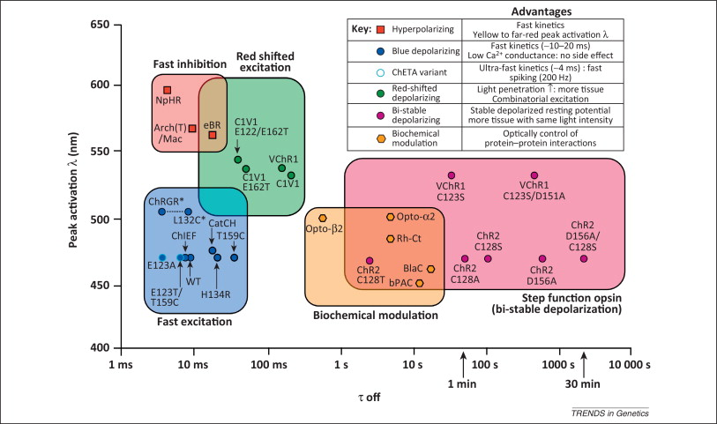
AAV & Stereotaxic Surgery
Materials & Methods
ORF (DIO) AAV5
D1-Cre & D2-Cre
ChETA_{A}-EYFP AKA ChR2(E123A) @ 470nM
Notes:
Double Inverted Open Reading Frame (DIO)

Slide 36
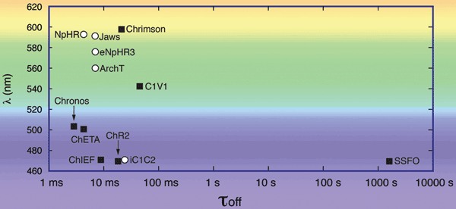
Variance
Materials & Methods

Slide 37
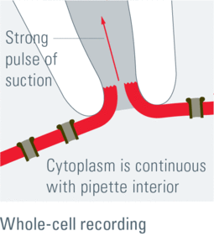
Voltage-Clamp Recordings
Materials & Methods
2-4 post SI = kill + extraction
Whole-cell patch clamp
MSN verification GFP, mCherry, EYFP
Cells held at -75mV

Slide 38
CSDS & SI
D1- & D2-Cre + D1- & D2-GFP
  10 day CSDS
  Exposure:
    Aggressive CD1 breeder
    10 min/day
    Housed with CD1 in divided cage
      X 10 days
      Novel CD1 each day
  Day 11- SI behavior screened—next slide please…

Slide 39
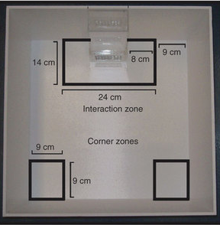
CSDS & SI
Placed in OF 2.5 min
Time in IZ recorded
CD1 in perforated box
Animals placed in OF
Time in IZ recorded
Animals susceptible if: 2 SD below mean of non-defeated animals
CSDS, OS, and Pharm Animals → 2nd SI Period

Slide 40
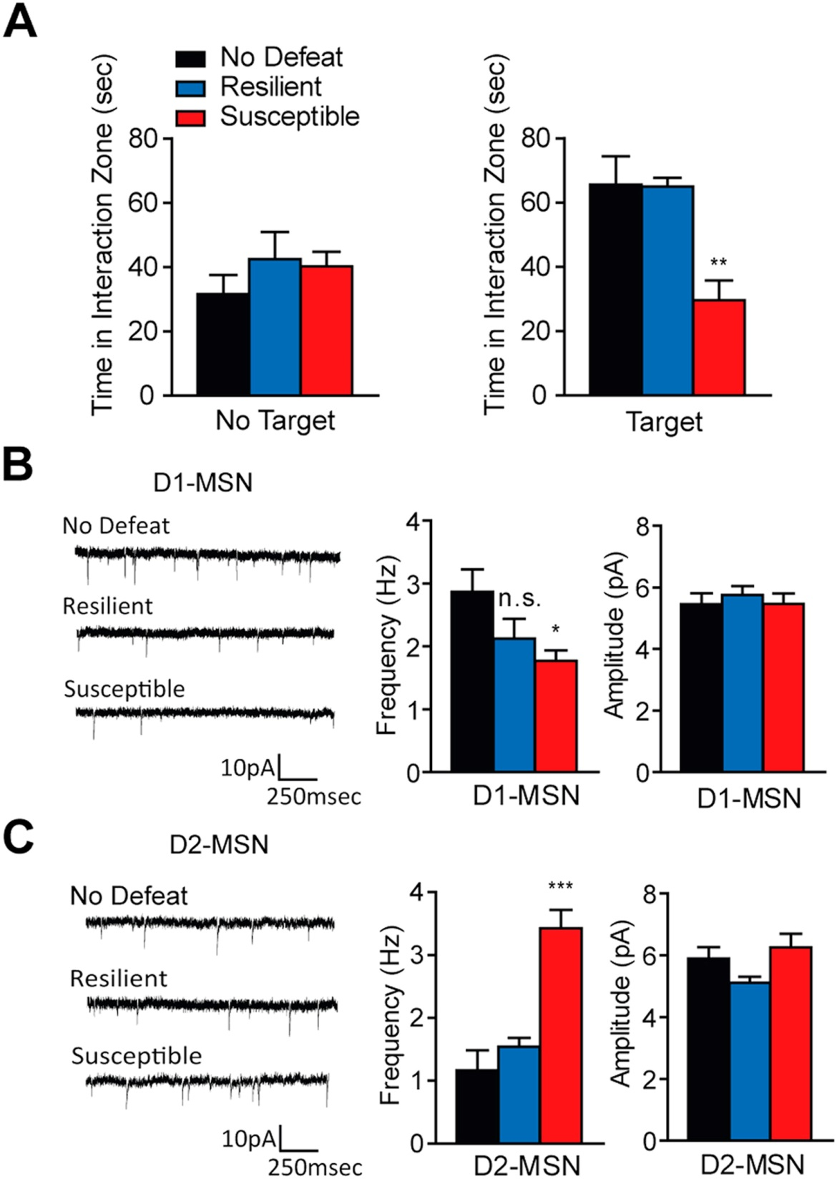
Excitatory input MSN
  CSDS
B) susceptible: ⬇ mEPSC freq in D1-MSN
C) susceptible: ⬆ mEPSC freq amplitude in D2-MSN
No change in amplitude for D1- or D2-MSNs’ mEPSC
Notes:
Miniature excitatory postsynaptic current (mEPSC)

Slide 41
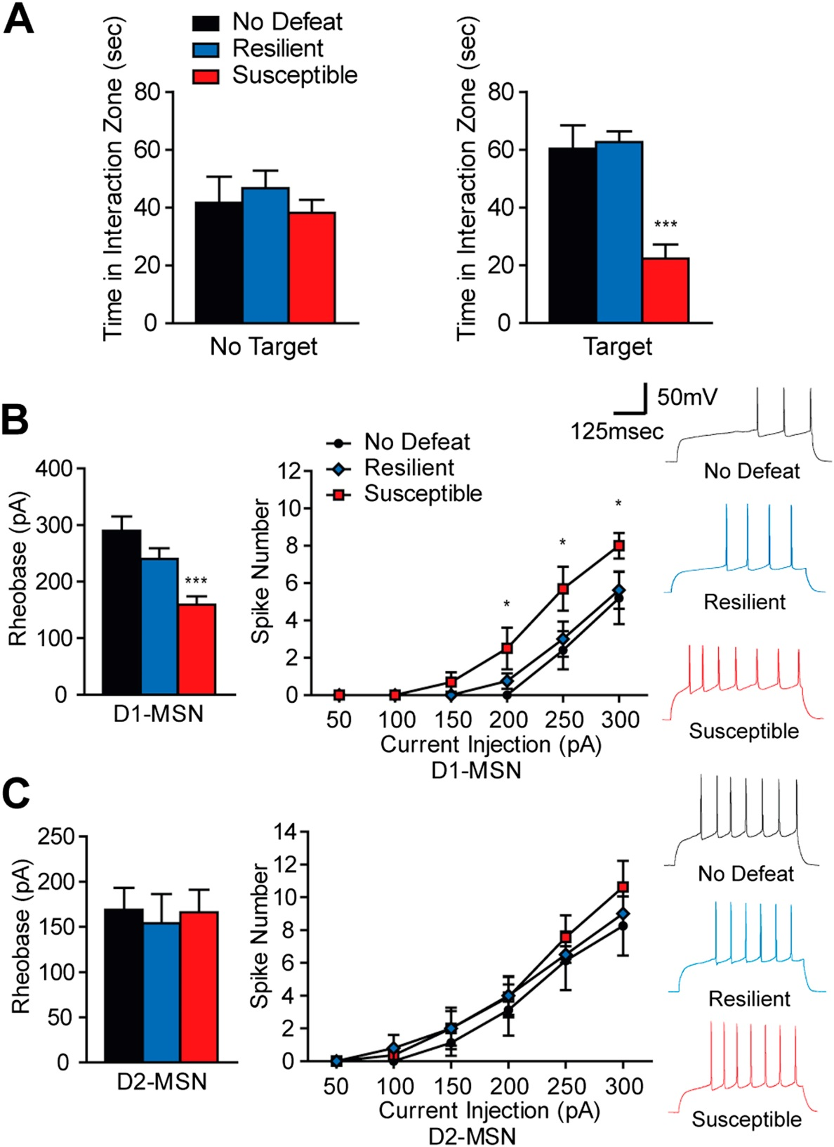
Intrinsic excitability in D1- & D2-MSNs after CSDS
B)susceptible = ⬆ rheobase & current evoked spikes in D1-MSNs
C) no Δ in rheobase or CESs in D2-MSNs
Notes:
Rheobase=the minimum amount of current necessary to elicit an action potential

Slide 42
Pharmacogenetic Inhibition After CSDS
D1- and D2-Cre mice injected bilaterally with AAV-DIO-hM4D (G_{i})-mCherry
CSDS Days 7-17
CNO (5mg/kg) or saline (.9%) injection: days 19-22
  CNO activate receptors
Day 23 injection as above @ 8am before SI

Slide 43
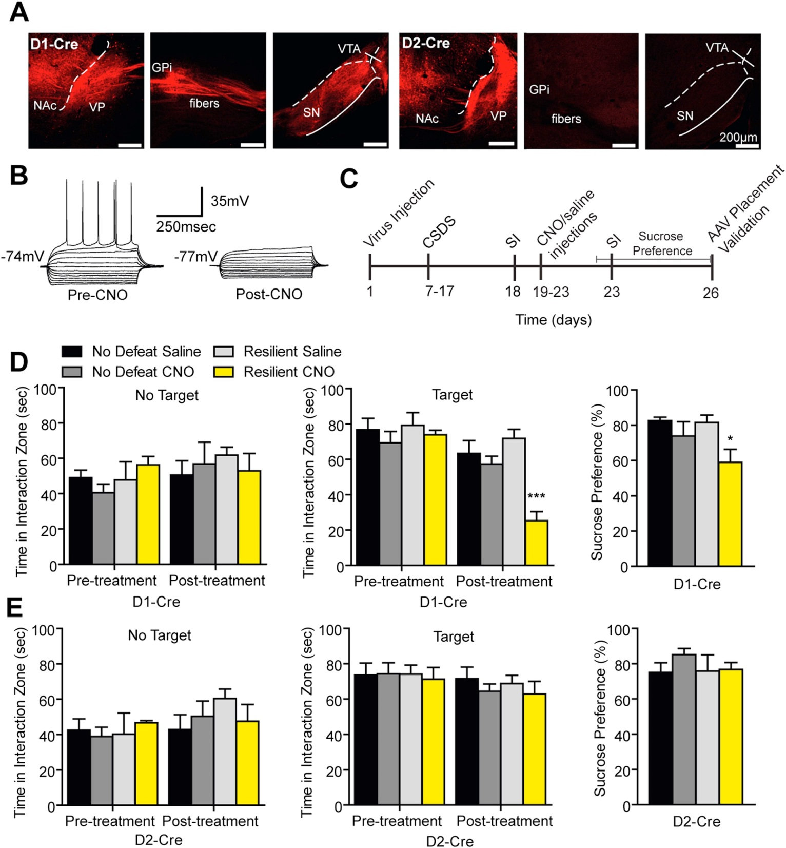
Notes:
D) In resilient D1-Cre mice repeated CNO injections reduced social interaction & sucrose preference without altering interaction times without target
E) D2-Cre = no effect

Slide 44
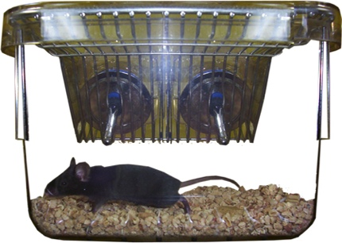
Sucrose Preference Test
Examined 2 days after:
  1st SI test SSDS
  2nd SI test CSDS
Two-bottle choice paradigm
  2 days prior—pre-test habituation to 2 water bottles
  One filled with 1% Suc
    Alternated daily
    Weight difference as a function of preference

Slide 45
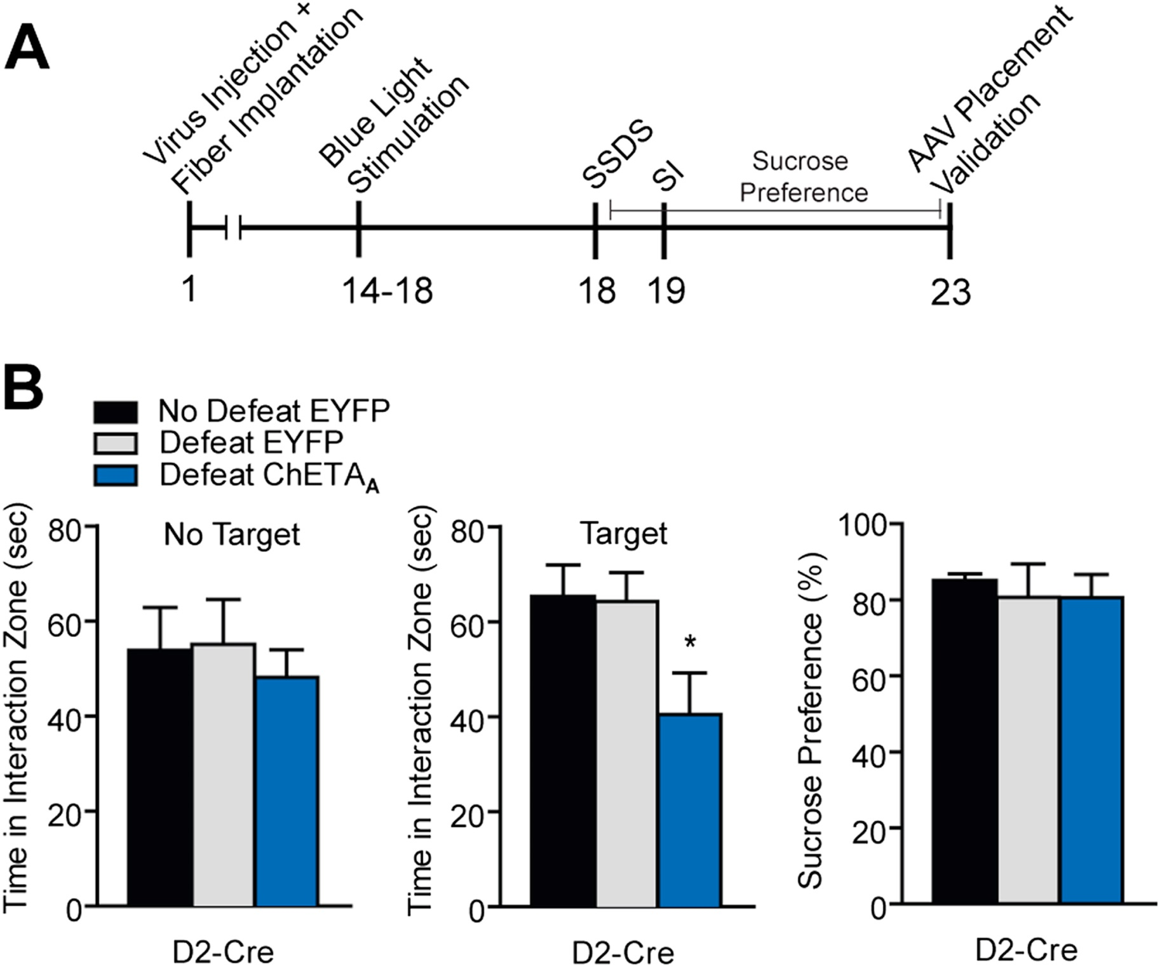

Slide 46
SSDS + OS
D1- and D2-Cre mice injected bilaterally with AAV-DIO-ChETA_{A}-EYFP
Chronic fibers
Day 4-17 morn + eve stim =50Hz @ 473 nm
  5 s on-off cycles
Day 18-Three social defeat sessions
  5 min physical defeat
  15 min no defeat
    OS during 15 min no defeat

Slide 47
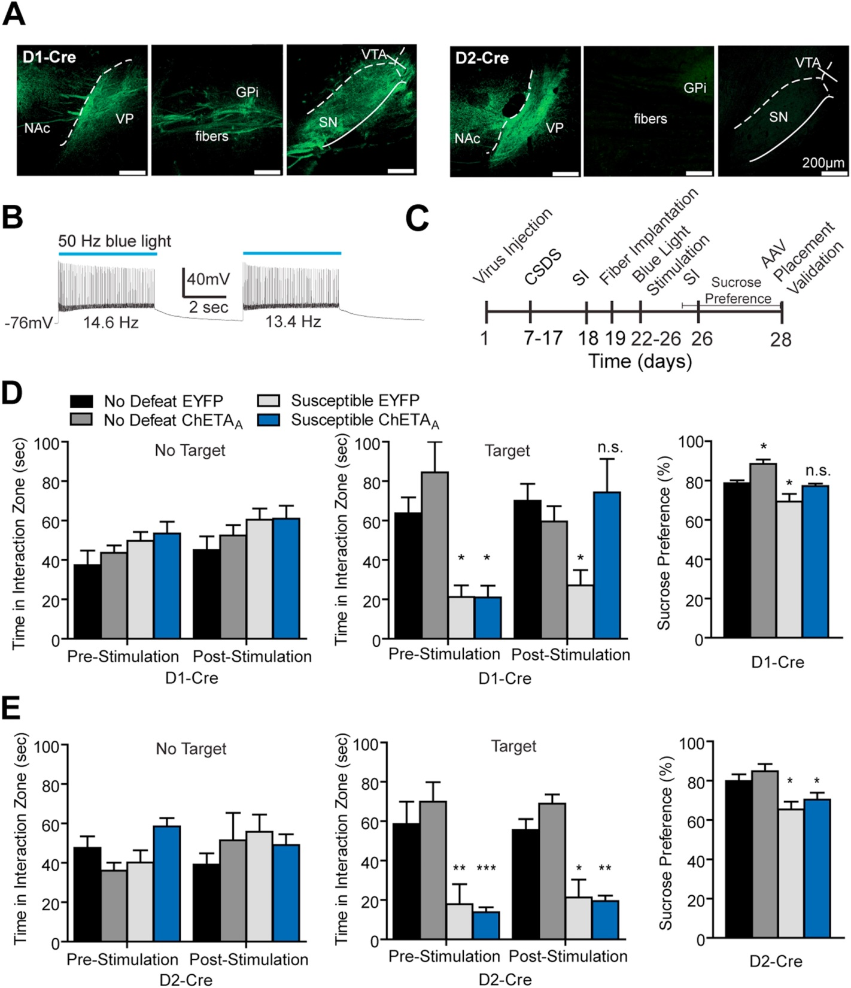

Slide 48
Results
NAc MSNs implicated in behavioral outcomes of SDS
Repeated OS of D1-MSN firing → restores SI and sucrose preference
Pharmacogenetic inhibition produces social avoidance + anhedonia
Repeated Os of D2-MSN→social avoidance following SSDS/no sucrose Δ

Slide 49
Results
^ of excitatory signaling and spine growth on MSNs in susceptible animals= D2-MSNs
vHipp afferent → D1-MSN role in stress behaviors
ΔFosB results indicate:
  ^ D1-MSN firing=positive, resilient outcomes following stress
  ^D2-MSN firing= promotes susceptibility
Repeated stimulation or inhibition → long-term plasticity adaptations in NAc

Slide 50


Background
  * Exposure to drug and drug-associated environmental backgrounds important
  How do GABAergic neurons respond to cocaine-associated context?
Notes:
Background: OS activation of D1- or D2-MSNs in NAc has been found to exert bidirectional control over cocaine conditioning
E.g., Learning drug as reward

Slide 51

Purpose of Study
Activation of NAc GABAergic Neurons
  OS + VGAT-ChR2 transgenic mice
NAc efferent-targeted regions examined
  OS GABAergic neurons
    During cocaine-context-associated memory expression

Slide 52
VP
NAc→^{GABA}→Ventral Pallidum (VP)
  VP – Regulation of motivation, behavior, & emotions…involved in drug addiction
VTA→^{DA}→VP
VP=Relay nucleus from NAc to Medial Dorsal Nucleus (via GABAergic MSNs)

Slide 53
Notes:
EYFP=Green, GAD67-positive neurons= Red

Slide 54
Animals
Materials & Methods
VGAT-ChR2 transgenic C57
  Expressing ChR2
    Fused to EYFP (ChR2-EYFP)
  Under control of VGAT promoter
    VGAT=Vesicular GABA Transporter
  8-12wks cannula placed bilat NAc
Notes:
7 day recovery before experiments

Slide 55
Optogenetics
Materials & Methods
Optic fibers placed with cannula adaptor
473nM
10Hz, 20ms @ 2 min duration w/2min interval
Notes:
7 day recovery before experiments

Slide 56
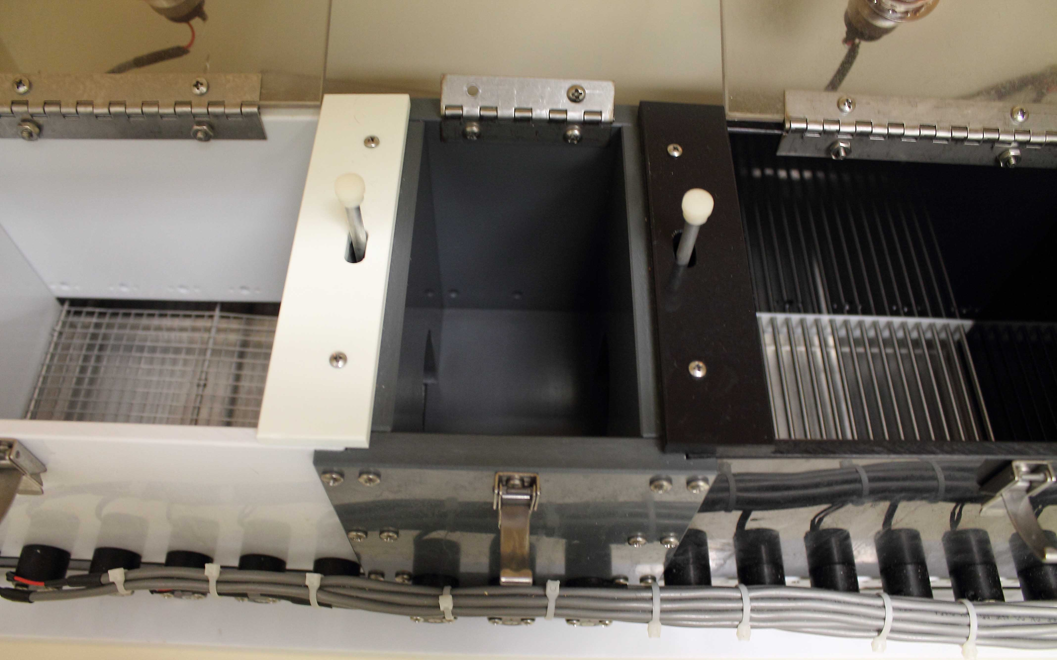
CPP Chamber
Materials & Methods
;

Slide 57
CPP Procedure
Conditioned Place Preference
Day 1 (PT): 20 min free explore whole apparatus
Day 2 & 3:
  AM: i.p. saline injection/ confined to one chamber x 20min
  PM: i.p. (15mg/kg) cocaine/ confined to opposite chamber x 20 min
Day 4: 20 min free explore whole apparatus
Scoring: CPP score=time spent in cocaine-paired chamber minus time spent in saline-paired chamber

Slide 58
OS Manipulation of Cocaine-Induced CPP
Conditioned Place Preference
Day 4: OS Manipulation
  OS fibers attached (cocaine-conditioned mice only)
  Exp 1:
    20 min free explore (whole chamber)-No OS
    20 min OS
  Exp 2:
    CPP tested with OS on throughout test-explore period.
Day 5: Tested again for CPP-time in each chamber recorded

Slide 60
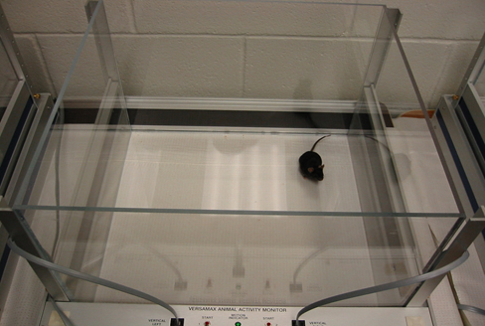
Open Field Test
Materials & Methods
Notes:
7 day recovery before experiments

Slide 61
Open Field Chamber
Effect of Cocaine on Locomotion
Day 1 & 2:
  i.p. saline
  30 min habituation open field (lm activity recorded)
Day 3-7:
  Placed in OFC x 30 min → i.p. cocaine
  Locomotion monitored for 60 min
Day 9: Mice w/ OS fibers
  In OFC x 30 min → i.p. cocaine
  Laser on
  Locomotion monitored for 60 min

Slide 62
B) Decrease c-Fos⁺ in VP

Slide 63
Results
NAc GABAergic transmission negativly regulates reward-seeking behavior induced by cocaine and cocaine-predictive cues
OS activation impairs CPP expression
(OS) reduced CPP → ⬇ c-Fos⁺ cells in VP
  Overlap D1 & D2 MSN NAc→VP inhibits VP activation → ⬇ drug seeking
NAc GABA inhibits SNr & VTA via D1-MSN
D1- & D2-MSNs (NAc→VP)→⬇ VP→⬇VP inhibition of SNr & VTA

Slide 64
Take-Home
Putting it All Together
OS MPST most effective for consistent DA release over time
Repeated OS may be problematic (inducing resilience or susceptibility to stress)
ES of field includes GABAergic MSNs, which may mimic attenuation of DA after CSDS

